Slide 1
Accelerating Google’s PageRank
Liz & Steve

Slide 2
Background
When a search query is entered in Google, the relevant results are returned to the user in an order that Google predetermines.
This order is determined by each web page’s PageRank value.
Google’s system of ranking web pages has made it the most widely used search engine available.
The PageRank vector is a stochastic vector that gives a numerical value (0<val<1) to each web page.
To compute this vector, Google uses a matrix denoting links between web pages.

Slide 3
Background
Main ideas:
Web pages with the highest number of inlinks should receive the highest rank.
The rank of a page P is to be determined by adding the (weighted) ranks of all the pages linking to P.
Notes:
Also, the personalization vector u can also manipulate where a page is ranked.

Slide 4
Background
Problem: Compute a PageRank vector that contains an meaningful rank of every web page
Notes:
Third formula is the power method!!! Which computes the dominant eigenvector of H

Slide 5
Power Method
The PageRank vector is the dominant eigenvector of the matrix H…after modification
Google currently uses the Power Method to compute this eigenvector. However, H is often not suitable for convergence.
Power Method:
Notes:
STOCHASITCITY makes dominant eigenvalue equal one
Irreducibility makes UNIQUE dominant eigenvector, pagerank vector

Slide 6
Creating a usable matrix
e is a vector of ones and u (for the moment)
is an arbitrary probabilistic vector.
Notes:
Last part makes G positive -> makes power meth converge.
Sparsity is gone
u can be manipulated for money or imporance

Slide 7
Using the Power Method
The rate of convergence is: , where is the
dominant eigenvalue and is the aptly named subdominant eigenvalue
Notes:
Lambda1=1
The smaller the magnitude of lambda2, the faster the power method converges

Slide 8
Alternative Methods: Linear Systems
Notes:
Branch off into two different areas of research: linear systems & IAD
Meyers version of dangling nodes reordering

Slide 9
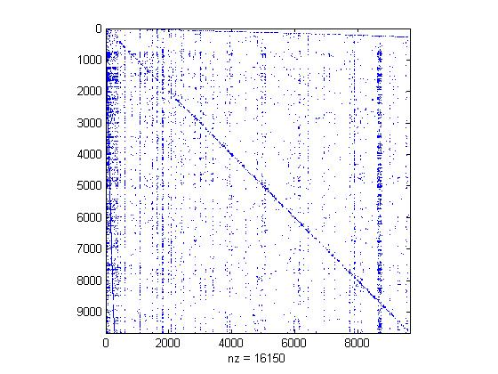
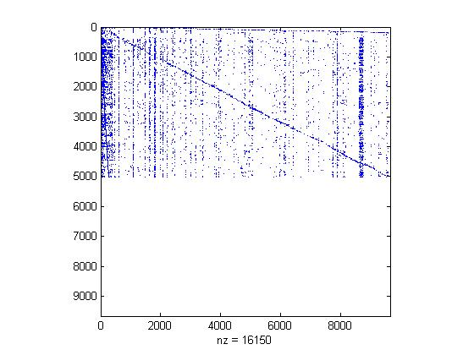
Langville & Meyer’s reordering

Slide 10
Alternative Methods: Iterative Aggregation/Disaggregation (IAD)
Notes:
u2 is stationary vector of the stochastic complement of G22
A makes a smaller matrix b/c it adds only one row to G11

Slide 11
IAD Algorithm
Form the matrix
Find the stationary vector
If , then stop. Otherwise,
Notes:
Tilde means approximation
How do we find the stationary vector (step2)

Slide 12
New Ideas: The Linear System In IAD
Notes:
Two unknowns: w & c
Set c as arbitrary and adjust

Slide 13
New Ideas: Finding and
Notes:
We can put G11 & G21 in terms of H to make them sparse again

Slide 14
Functional Codes
Power Method
We duplicated Google’s formulation of the power method in order to have a base time with which to compare our results
A basic linear solver
We used Gauss-Seidel method to solve the very basic linear system:
We also experimented with reordering by row degree before solving the aforementioned system.
Langville & Meyer’s Linear System Algorithm
Used as another time benchmark against our algorithms

Slide 15
Functional Codes (cont’d)
IAD - using power method to find w₁
We used the power method to find the dominant eigenvector of the aggregated matrix A. The rescaling constant, c, is merely the last entry of the dominant eigenvector
IAD – using a linear system to find w₁
We found the dominant eigenvector as discussed earlier, using some new reorderings

Slide 16
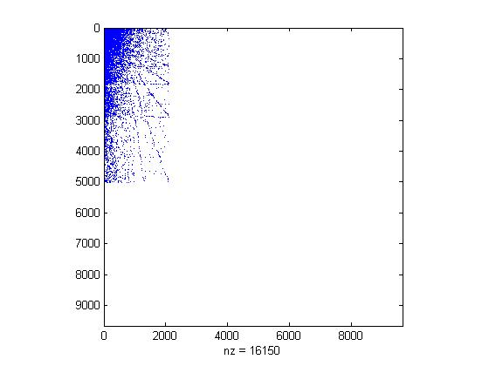
And now… The Winner!
Power Method with preconditioning
Applying a row and column reordering by decreasing degree almost always reduces the number of iterations required to converge.
Notes:
Talk about our reordering method
RUN Stanford example with and without reordering… Focus on time differences… SPY THE MATRIX

Slide 17
Why this works…
The power method converges faster as the magnitude of the subdominant eigenvalue decreases
Tugrul Dayar found that partitioning a matrix in such a way that its off-diagonal blocks are close to 0, forces the dominant eigenvalue of the iteration matrix closer to 0. This is somehow related to the subdominant eigenvalue of the coefficient matrix in power method.
Notes:
Run MATLAB Eigenvalue Example

Slide 18
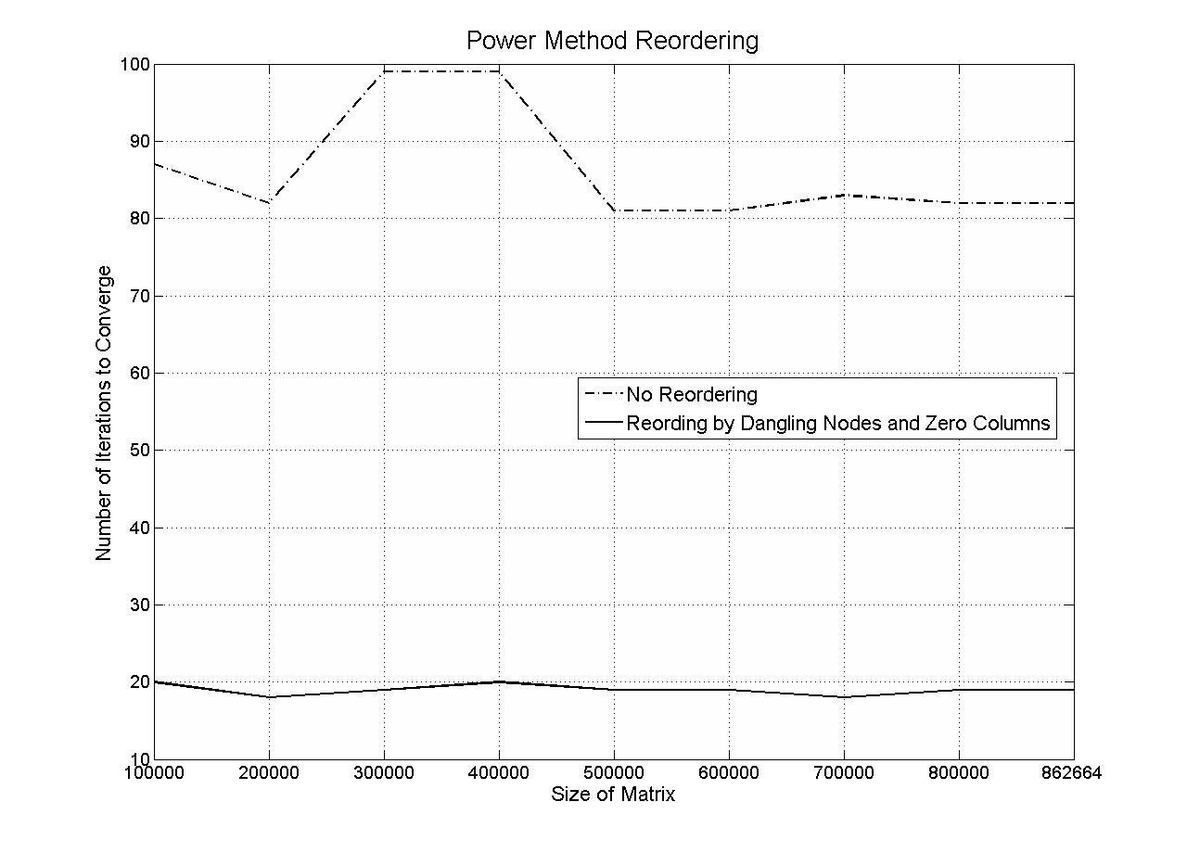
Decreased Iterations

Slide 19
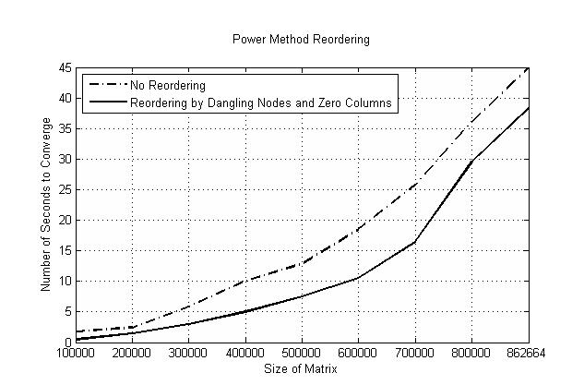
Decreased Time

Slide 20
Some Comparisons
 | Calif | Stan | CNR | Stan Berk | EU
Sample Size | 87 | 57 | 66 | 69 | 58
Interval Size | 100 | 5000 | 5000 | 10000 | 15000
Mean Time Pwr/Reorder | 1.6334 | 2.2081 | 2.1136 | 1.4801 | 2.2410
STD Time Pwr/Reorder | 0.6000 | 0.3210 | 0.1634 | 0.2397 | 0.2823
Mean Iter Pwr/Reorder | 2.0880 | 4.3903 | 4.3856 | 3.7297 | 4.4752
STD Iter Pwr/Reorder | 0.9067 | 0.7636 | 0.7732 | 0.6795 | 0.6085
Favorable | 100.00% | 98.25% | 100.00% | 100.00% | 100.00%

Slide 21
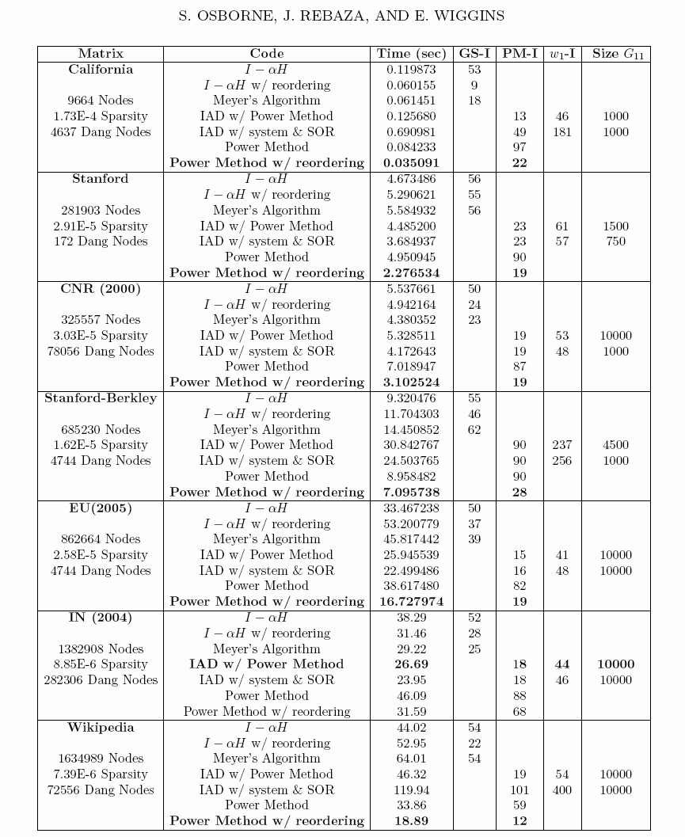

Slide 22
Future Research
Test with more advanced numerical algorithms for linear systems (Krylov subspaces methods and preconditioners, i.e. GMRES, BICG, ILU, etc.)
Test with other reorderings for all methods
Test with larger matrices (find a supercomputer that works)
Attempt a theoretical proof of the decrease in the magnitude of the subdominant eigenvalue as result of reorderings.
Convert codes to low level languages (C++, etc.)
Decode MATLAB’s spy
Notes:
Minimize ||b – A*x||
Need a bigger computer for
Storage
Computation speed
Show the SPIES

Slide 23
Langville & Meyer’s Algorithm

Slide 24
Theorem: Perron-Frobenius
If is a non-negative irreducible matrix, then
is a positive eigenvalue of
There is a positive eigenvector associated with
has algebraic and geometric multiplicity 1

Slide 25
The Power Method: Two Assumptions
The complete set of eigenvectors are linearly independent
For each eigenvector there exists eigenvalues such that

