Slide 1
A Spectral Analysis of Cyclic and Elementary Abelian Subgroup Lattices
Christopher M. P. Tomaszewski
30 july MMIX

Slide 2
Background Material
Recall the definitions of:
Group
Graph
Subgroup Lattice – A graph where each subgroup is a vertex and two subgroups are connected iff one is a subgroup of the other without any intervening subgroups.
Direct Product
Adjacency Matrix – A square, symmetric matrix which represents a graph by placing a 1 in the i-th row and j-th column if i ~ j and a 0 elsewhere.
Characteristic Polynomial
Eigenvalue
Spectrum – The set of eigenvalues of the adjacency matrix of a graph

Slide 3
Background Material
Recall: Group Subgroup graph Adjacency matrix Characteristic polynomial Eigenvalues
For example:

Slide 4
Graph Products
A graph product is a binary operation, denoted “□”, on graphs which induces a new graph over the Cartesian product of the graph vertices:
where iff

Slide 5
Graph Products (Cont’d)
For example:
NB: When one of the graphs is a path graph, such as here, the graph product has the visual effect of “projecting” the other graph into the next dimension.
(2,2)
2
2
□
(2,1)
(2,3)
=
(1,2)
1
1
3
(1,1)
(1,3)

Slide 6
Cyclic Groups
A cyclic group is a group such that all elements of the group can be expressed as a power of a single element of the group, called a generator, of which there may be more than one in the group.
Every cyclic group of order n is isomorphic to (essentially the same as) a group of the form {0, 1, 2, 3…n-1} under addition modulo n, denoted .

Slide 7
Cyclic Groups (Cont’d)
Rewriting :
where
A group of the form is called a p-group.

Slide 8
Cyclic Groups (Cont’d)
Theorem:
That is, every cyclic group is the direct product of p-groups where the orders of the p-groups are the prime-power factors of the order of the cyclic group.

Slide 9
Graph Product – Direct Product
Theorem:
That is, the subgroup lattice of a direct product is equal to the graph product of the component subgroup lattices if the groups are coprime.
Because the component p-groups of a cyclic group are always pairwise coprime, the subgroup lattice of every cyclic group is the graph product of all its component p-group subgroup lattices.

Slide 10
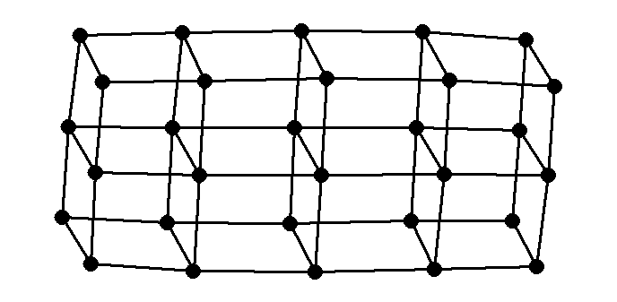
Graph Product – Direct Product (Cont’d)
Because the subgroup lattice of every p-group is a path graph, this means that the subgroup lattice of every cyclic group is a simple cubic lattice in n dimensions, where n is the number of distinct p-groups which produce the cyclic group.

Slide 11
Graph Product – Adjacency Matrix
Taking a graph product has a predictably regular effect on the adjacency matrix of the product graph:
That is, the adjacency matrix of the product graph is a block matrix composed of one of the adjacency matrices along the diagonal and identities of equal dimension where the other matrix’ entries equal 1.

Slide 12
Tridiagonal Block Matrices
Because p-group adjacency matrices are always tridiagonal, (non-zero entries are restricted to the diagonal, superdiagonal, and subdiagonal) the adjacency matrix of arbitrarily many p-groups is always a tridiagonal block matrix.
Thus, every cyclic group adjacency matrix has a tridiagonal block form.
There is a formula to give the determinant of such matrices. [Molinari, 2008]

Slide 13
Prime Result
Theorem: Given any cyclic group, , its eigenvalues are
That is, its spectrum is the Cartesian sum of the spectra of all its component p-groups.
This settles the matter for all cyclic groups.

Slide 14
Elementary Abelian Groups
An elementary Abelian group is a group of the form
These are interesting because is a field, which means that is a finite vector space where subgroups correspond to subspaces. This allows us to more easily determine the subgroup lattice structure of these groups and also their spectra.

Slide 15
Elementary Abelian Groups (Cont’d)
Elementary Abelian groups are also very interesting because they are the first case of the larger family of groups, , the carefully chosen subgroups of which, for distinct p, comprise all the coprime factors of any Abelian group.
Results:
This gives the spectrum for all groups of the form
These matrices are also tridiagonal in general, so this is promising.

Slide 16
What’s Next
Continue exploring block matrix methods in solving all elementary Abelian groups.
Expand upon these methods to solve all Abelian groups.
Solve dihedral groups and other semidirect products.
What can be said about non-isomorphic groups with cospectral subgroup lattices?
Spectra of subring lattices?
And for something completely different: what groups have subgroup lattices of genus 1 (can be drawn on a torus without intersection)?

